Slide 1
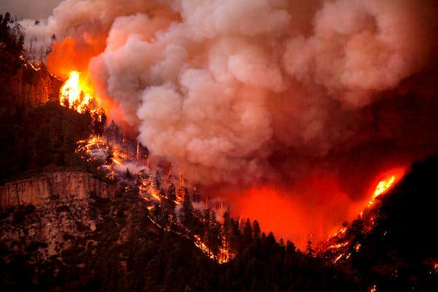

Custom Loss Functions in Fuel Moisture Modeling
Jonathon Hirschi
CU Denver
MS in Statistics Project
July 22nd 2024
Hermosa, Colorado 2018 (Source: NYT)

Slide 2
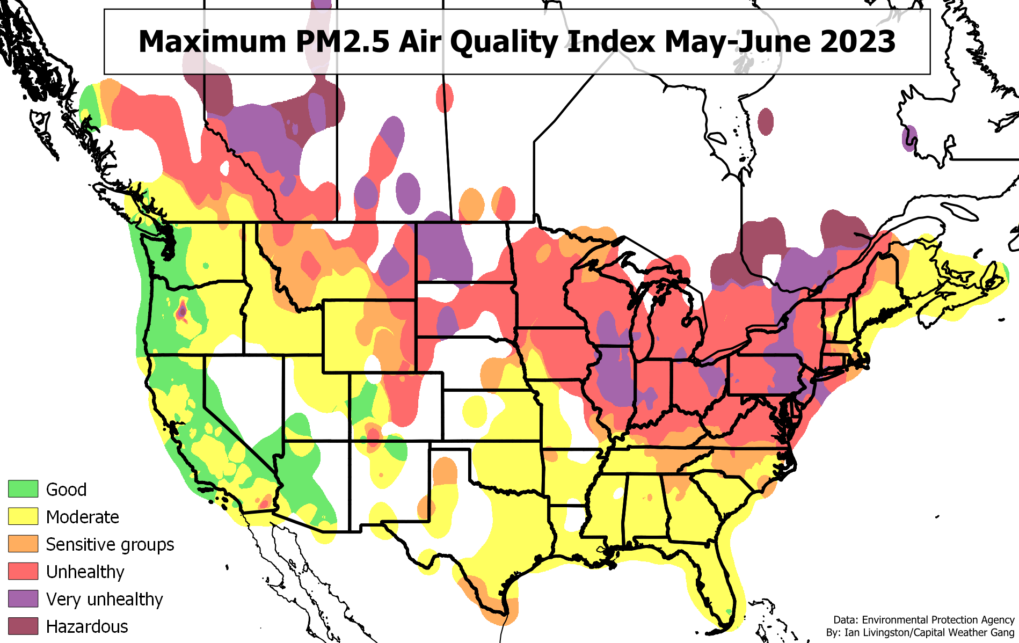
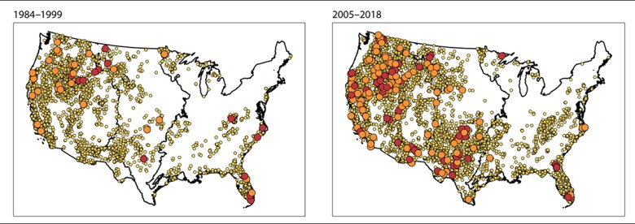
Wildfires & Climate Change
Wildfires are one of the main natural disasters that affect us in the United States
Wildfires affect our lives through property damage & adverse health affects on air and water
Climate change is increasing the frequency and the severity of wildfires
Fire Distribution & Size
Cartier 2022

Slide 3
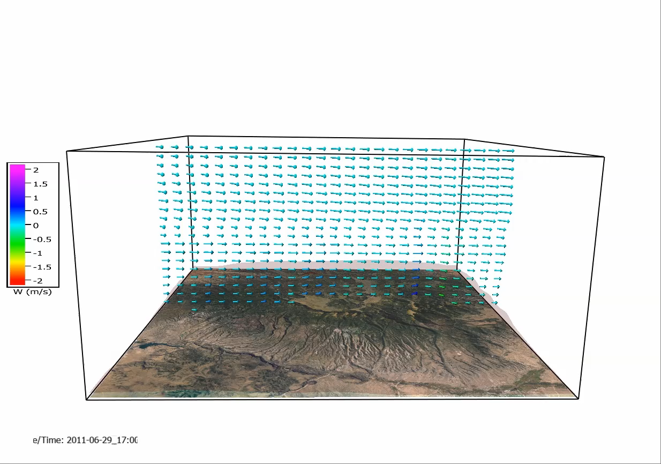
Wildfire Research & Modeling
Researchers are attempting to predict the behavior of wildfires with computational models
Wildfire modeling can help inform first responders
WRF-SFIRE is a real-time wildfire simulation project
There have been major advances, but there is still a lot of uncertainty
Las Conchas Fire Simulation
OpenWFM

Slide 4
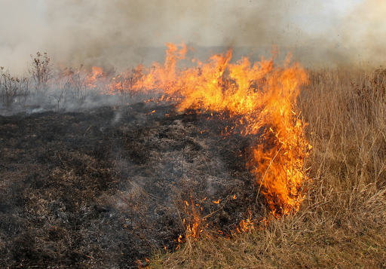
Wildfire Rate of Spread
Rate of Spread (ROS) is a measure of the speed at which a fire spreads from a point of origin
It is one of the primary quantities of interest for wildfire researchers
Many environmental factors affect ROS, including weather and physical fuel properties
Controlled Burn in Virginia
Source: National Park Service

Slide 5
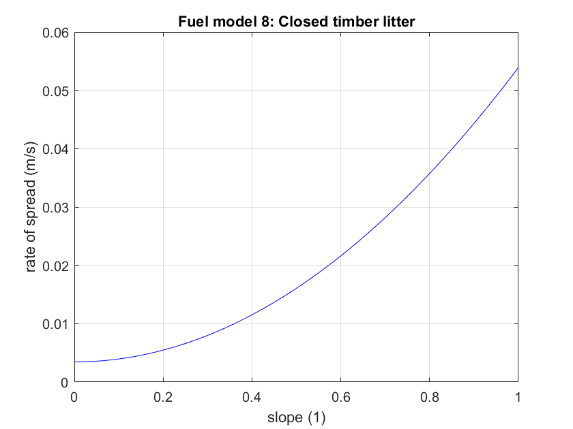
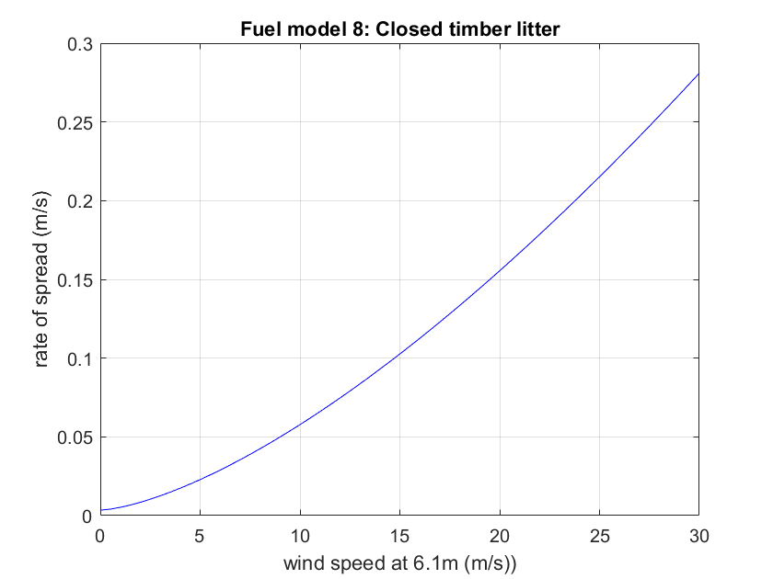
Wildfire Rate of Spread
Terrain slope affects ROS
Fire moves fastest uphill
Wind speed is a major driver of ROS
Stronger winds spread fire faster
Source: OpenWFM

Slide 6

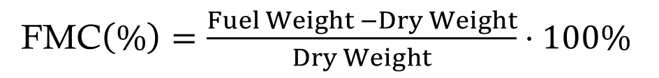
Fuel Moisture Content Background
Fuel Moisture Content (FMC) measures the water content of burnable fuels
FMC is a key predictor of fire behavior
It is the ratio of water in the fuel relative to the “dry weight”
Real-world fuels are a complicated mix of wood and herbaceous material
Live FMC depends on biological properties of plants and resists rapid changes due to weather
Measured through labor-intensive field work
FMC$\left(\%\right)=\frac{Fuel Weight −Dry Weight}{Dry Weight}⋅100\%$
Sage Brush

Slide 7
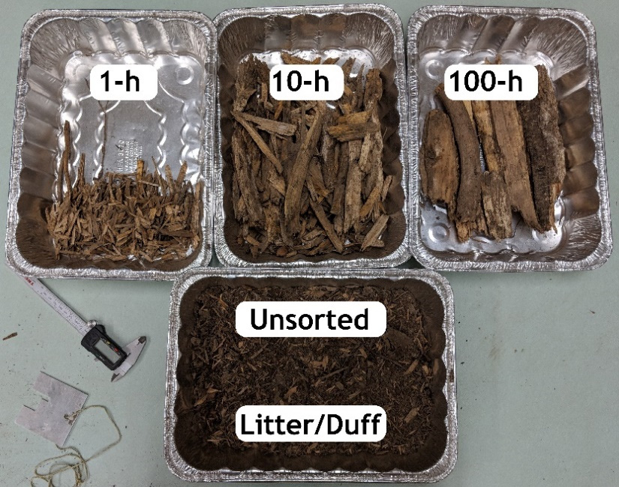

Dead Fuel Moisture Content
Fuel Moisture Content (FMC) measures the water content of burnable fuels
Dead FMC responds quickly to changes in weather
Dead fuels divided into “classes”, which correspond to how quickly they change moisture
FMC$\left(\%\right)=\frac{Fuel Weight −Dry Weight}{Dry Weight}∗100\%$
Time Lag | Fuel Size (diameter)
1-hour | Less than 1/4 in.
10-hour | 1/4 - 1 in.
100-Hour | 1-3 in.
1000-Hour | 3-8 in.
Source: NOAA
Source: Becker (2020)

Slide 8
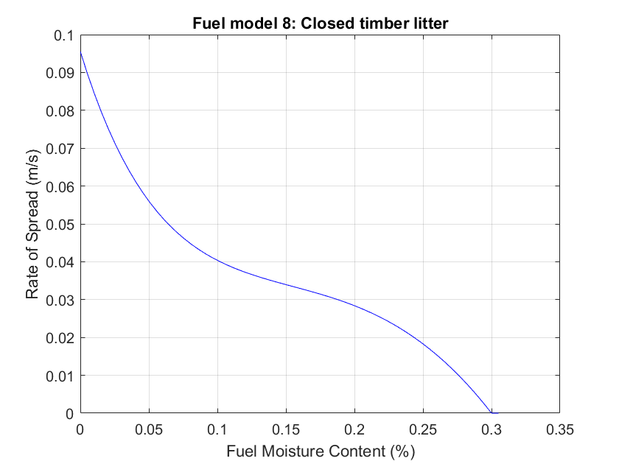
Fuel Moisture Content and Rate of Spread
Fuel moisture is one of the main predictors of ROS
Small differences in FMC at values closer to 0% lead to large difference in ROS
Burnable fuels have an Extinction Moisture, where fire does not spread at all
Zero slope & Wind speed 3m/s
Source: OpenWFM

Slide 9
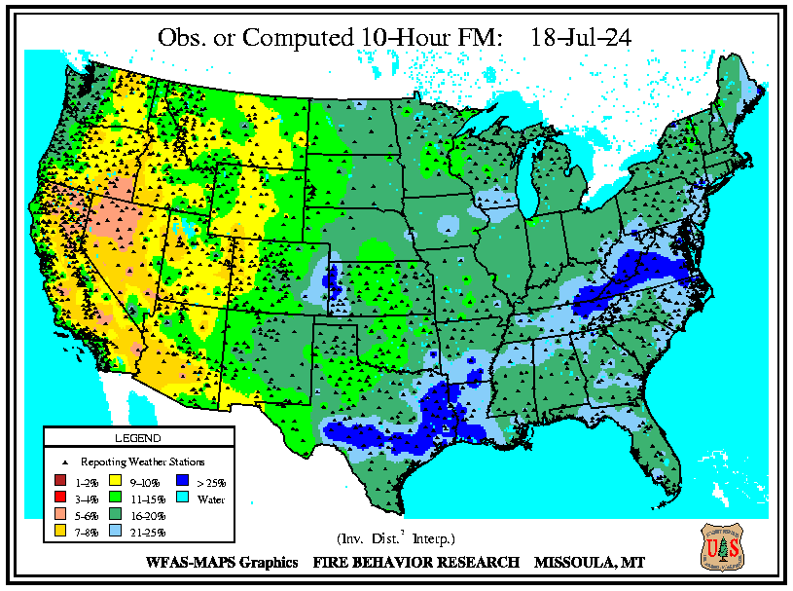
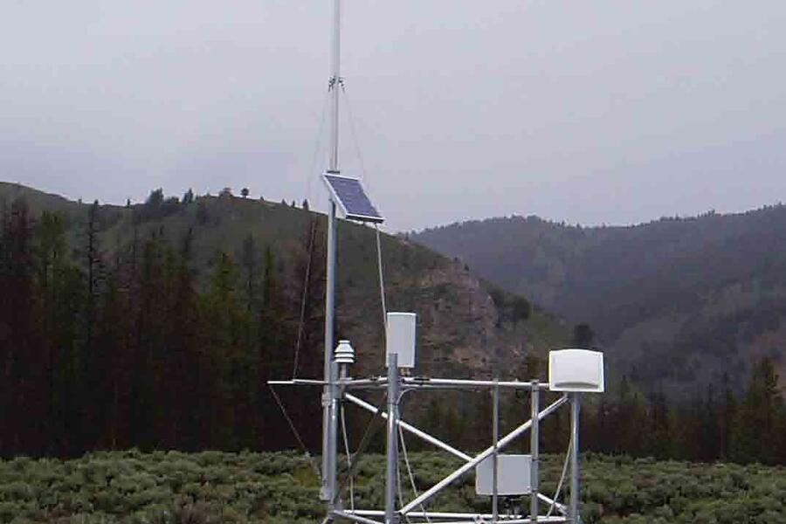
Monitoring Fuel Moisture Content - RAWS
The National Interagency Fire Center (NIFC) is a major collaboration of researchers, firefighters, etc.
NIFC operates Remote Automatic Weather Stations (RAWS) across the country to measure hourly FMC and other associated environmental variables.
Almost all FMC observations are for 10-h fuels (1/2 in. sticks)
All RAWS Locations
RAWS Monitoring Station

Slide 10
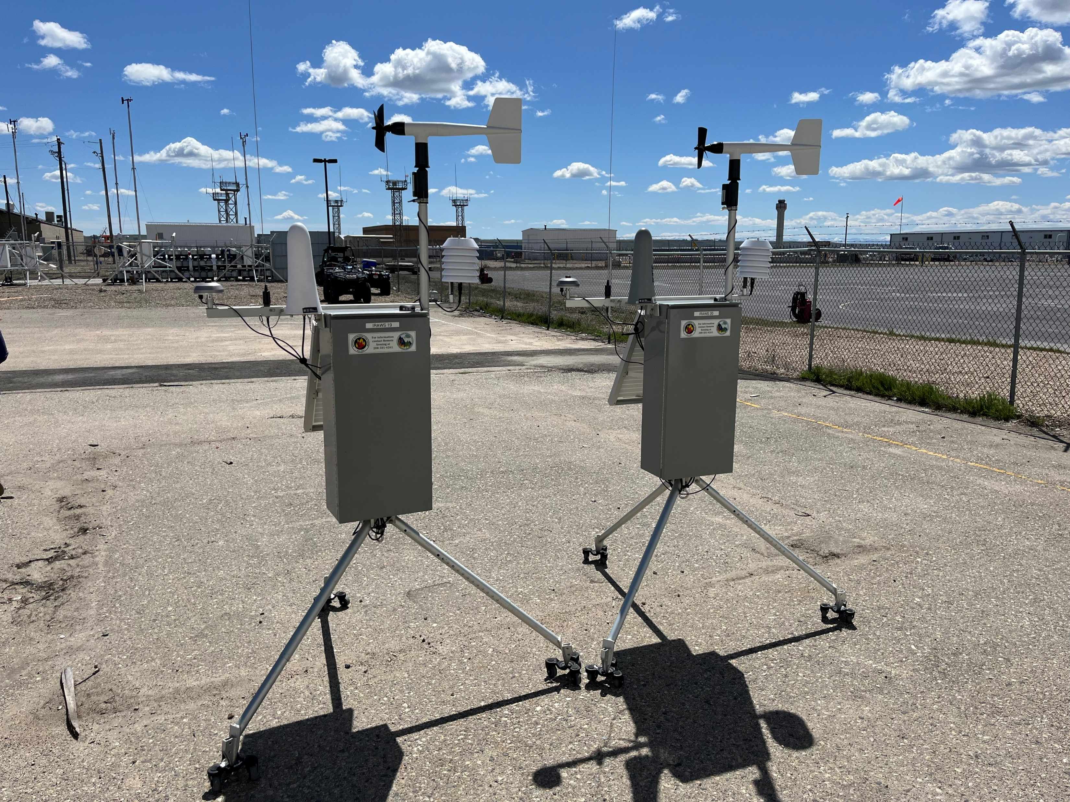

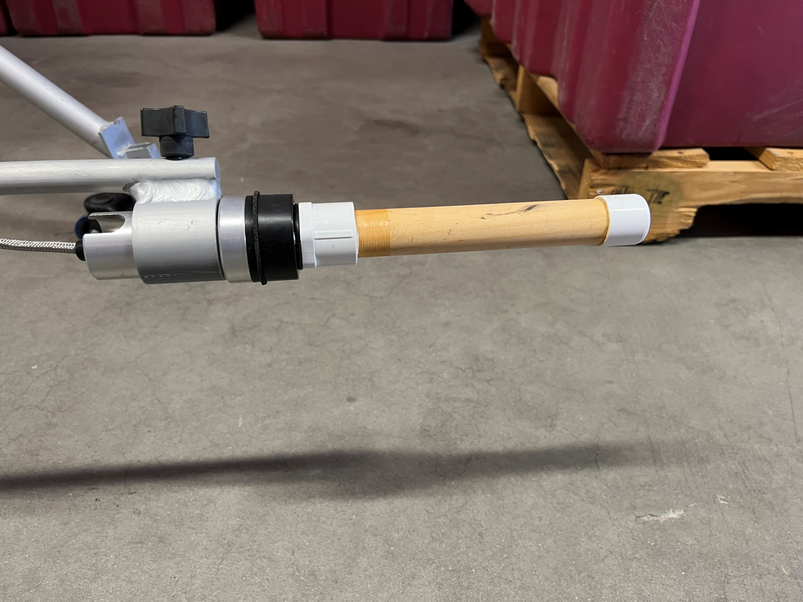
Remote Automated Weather Stations RAWS

Slide 11
Remote Automated Weather Stations RAWS
Wind Sensor
FMC Sensor
Rain Bucket

Slide 12


Remote Automated Weather Stations RAWS

Slide 13
Remote Automated Weather Stations RAWS
Me
Jan

Slide 14
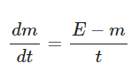
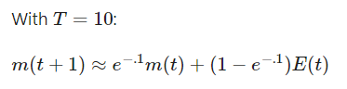
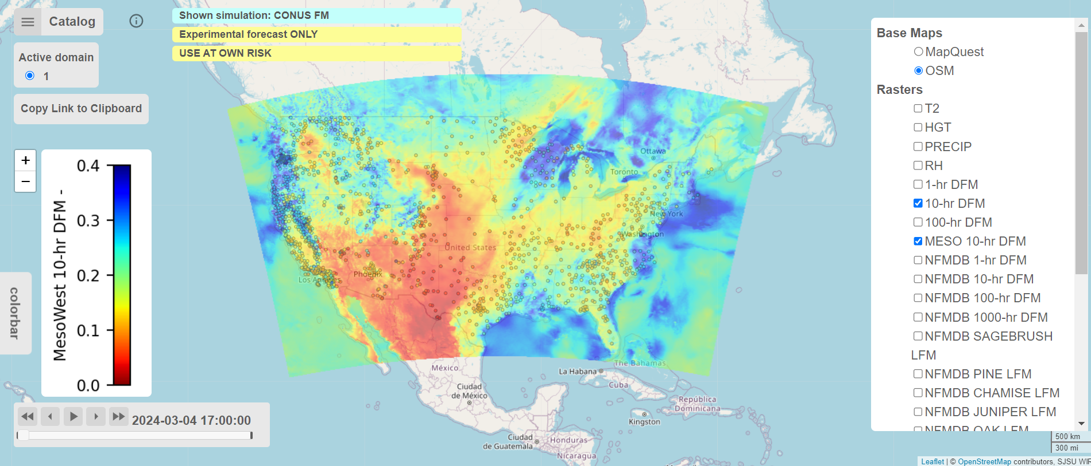
Fuel Moisture Modeling
RAWS data are used within mathematical models of FMC
FMC predictions are used as inputs to wildfire models
Traditionally, mathematical models of FMC are based on physics
Most physics-based models use some combination of temperature, relative humidity, and rain
More recently, Machine Learning (ML) models of FMC are becoming more popular
Mandel et al. (2014)
Source: OpenWFM

Slide 15
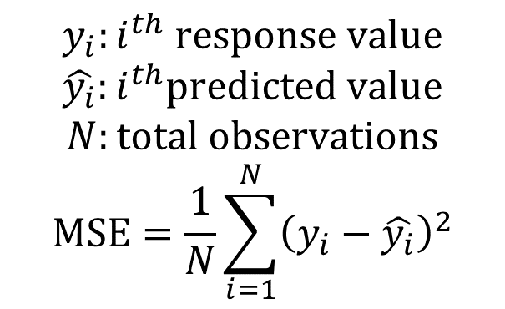
Loss Functions in Machine Learning
ML is a general term for statistical models that learn the patterns of observed data and are used to predict new, unobserved data
A Loss Function is intended to measure the fitting accuracy of a statistical model
Loss functions are used for training the parameters of ML models
Generally, loss functions are some function of the model residuals, or the difference between observed data and predicted values
Model parameters are chosen that minimize the loss function
When the response variable is continuous, the typically loss function is the Mean Squared Error (MSE)
Model parameters chosen to minimize
$$y_{i}:i^{th} response value$$
$\hat{y_{i}}:i^{th}predicted value$
$$N:total observations$$
$$MSE=\frac{1}{N}\sum_{i=1}^{N}{{\left(y_{i}−\hat{y_{i}}\right)}^{2}}$$

Slide 16
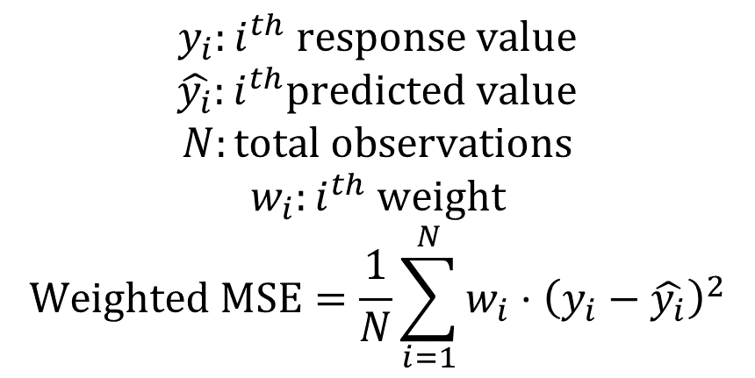
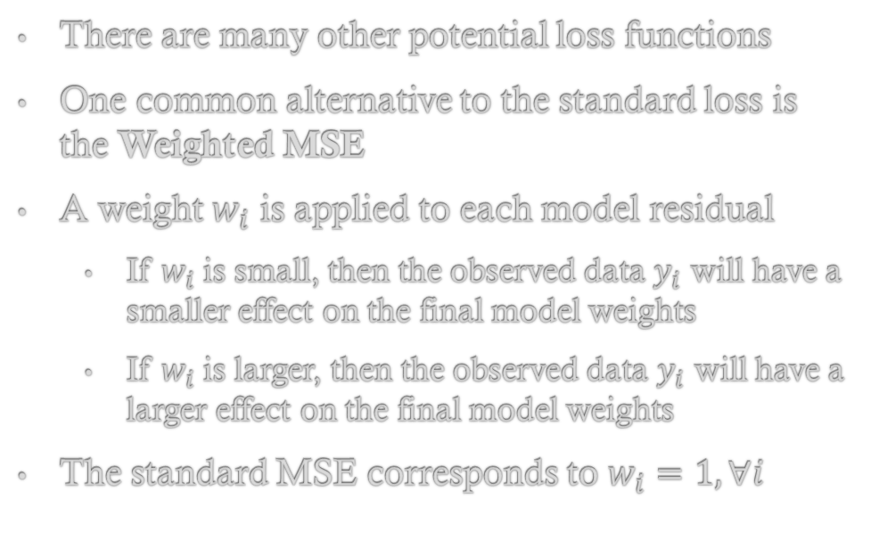
Loss Functions in Machine Learning
There are many other potential loss functions
One common alternative to the standard loss is the Weighted MSE
A weight $w_{i}$ is applied to each model residual
If $w_{i}$ is small, then the observed data $y_{i}$ will have a smaller effect on the final model weights
If $w_{i}$ is larger, then the observed data $y_{i}$ will have a larger effect on the final model weights
The standard MSE corresponds to $w_{i}=1, ∀i$
$$y_{i}:i^{th} response value$$
$\hat{y_{i}}:i^{th}predicted value$
$$N:total observations$$
$$w_{i}:i^{th} weight$$
$$Weighted MSE=\frac{1}{N}\sum_{i=1}^{N}{{w_{i}⋅\left(y_{i}−\hat{y_{i}}\right)}^{2}}$$

Slide 17
Research Question
Can Custom Loss Functions that place more importance on dry fuels be used to improve predictions of wildfire Rate of Spread?
Analysis Overview:
Collect observations of FMC and key predictors
Train multiple ML models using different custom loss functions
Analyze which loss functions lead to the best ROS predictions based on RMSE on test set

Slide 18
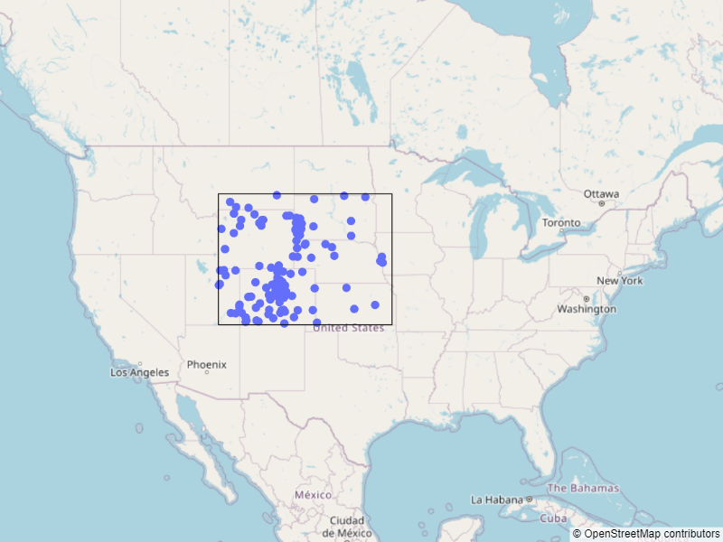
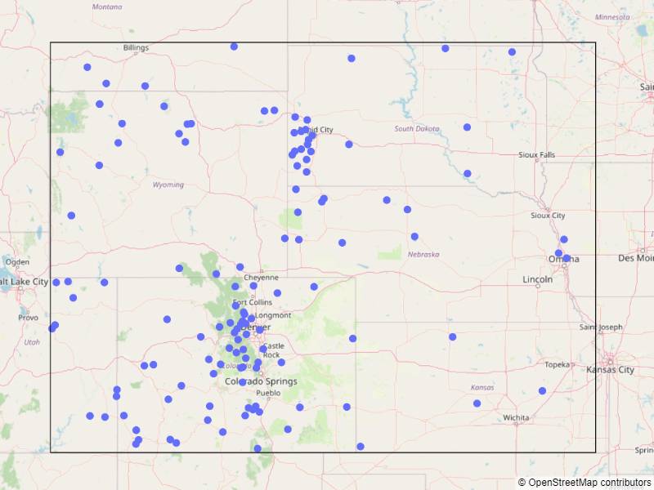
Data Collection
Observations were collected from all RAWS within the Rocky Mountain region
1 year of FMC and predictor data collected from May 2023 through May 2024
Synoptic data API used with Python software package SynopticPy
Data was filtered for missing and erroneous values
Rocky Mountain GACC

Slide 19
Data Summary
875,130 total observations collected
Equilibrium Moisture calculated from RH and T
Physical characteristics of RAWS locations extracted, including elevation, longitude, and latitude
Day of year (1-365) and hour of day (0-23) extracted from time record of observations
A total of 9 predictor variables used for modeling
Predictor Name | Units | Description
Equilibrium Moisture | % | Derived from RH and temperature
Precipitation | mm/h | Calculated from all rain accumulated over the hour
Wind Speed | m/s | Wind speed at 20ft above from
Solar Radiation | kWh/m² | Downward shortwave radiation
Elevation | feet | Height above sea level
Hour | hours | From 0 to 23, UTC time
Day of Year | days | From 0 to 365 or 366*
Latitude | degrees | North to South spatial coordinate
Longitude | degrees | East to West spatial coordinate
All Predictor Variables

Slide 20
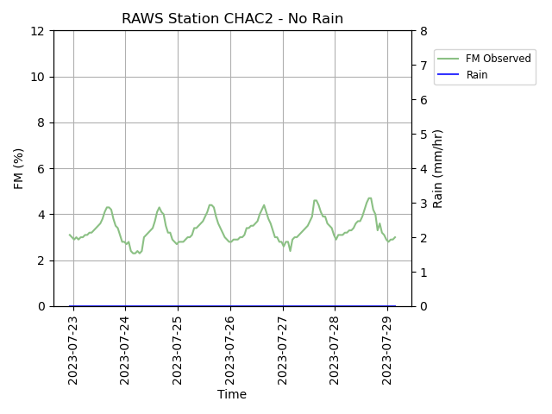
Data Exploration – Time
Cyclical, diurnal pattern in time
FMC highest at night just after peak humidity and lowest temperatures
FMC lowest just after the heat of the day in the early afternoon just after lowest humidity and peak temperatures
Time lag between peak FMC and corresponding extreme predictors depends on the fuel class e.g., 10-h fuels

Slide 21
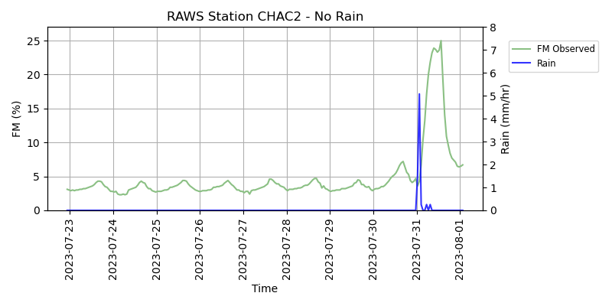
Data Exploration – Precipitation
Precipitation causes rapid increases in FMC
This pattern is one of the biggest challenges to accurate FMC modeling
FMC models perform the worst following rain events, but these times are also associated with very low potential ROS

Slide 22
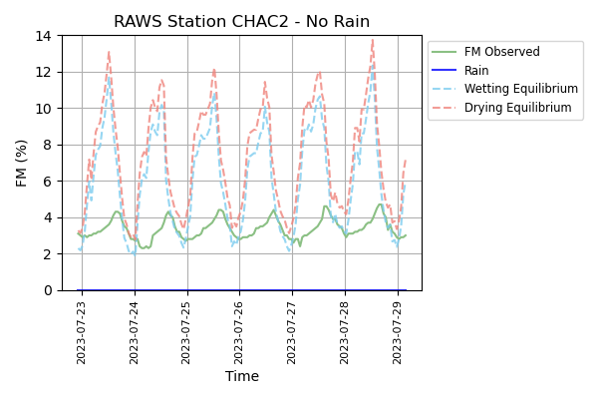
Data Exploration – Equilibrium Moisture
Equilibrium Moisture Content is a stable FMC in an environment constant in time
It is modeled as a function of RH (%) and T (^{º}K)
FMC approaches an equilibrium over time
Hysteresis approximation – drying and wetting equilibrium are different
Many FMC models utilize equilibrium moisture as a predictor
In this project, only drying equilibrium used
E$quilibrium Moisture Content \left(\%\right)=f(RH, T)$

Slide 23

Data Exploration – Converting FMC to ROS
FMC values transformed to ROS using idealized curve for fuel type most similar to 10-h FMC sensors
Fuel model 8 is “closed timber litter”, a mixture of dead material on the ground that characterized as majority 10-h fuels
Error for predicting ROS on test set is the main quantity of interest in this project
R$OS\left(m/s\right)=f(FMC)$

Slide 24
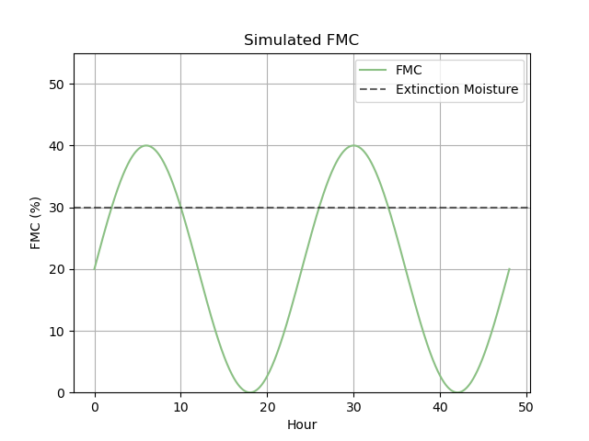
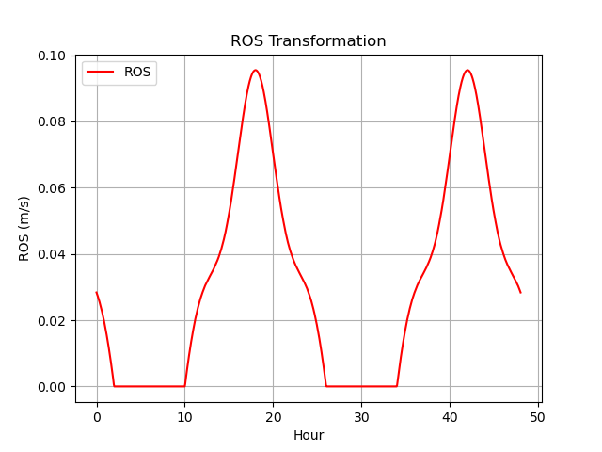
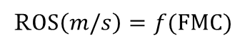
Converting FMC to ROS
FMC values transformed to ROS using idealized curve
Error for predicting ROS on test set is the main quantity of interest in this project
R$OS\left(m/s\right)=f(FMC)$

Slide 25
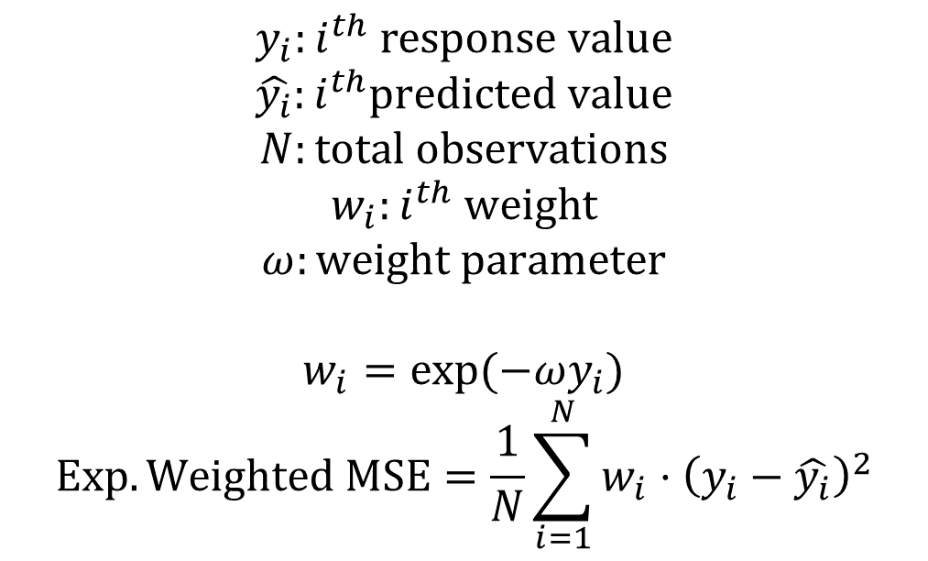
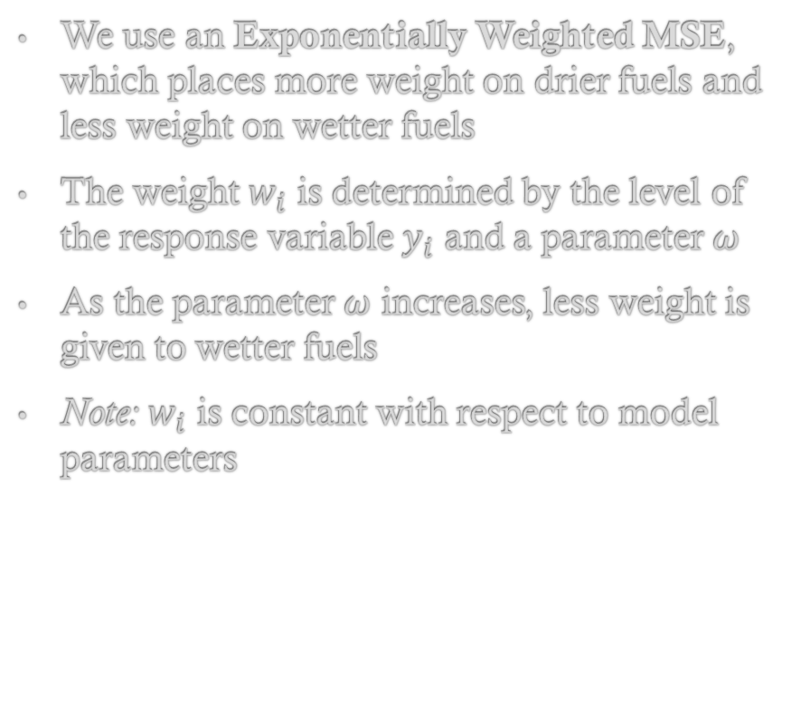
Proposed Loss Functions
We use an Exponentially Weighted MSE, which places more weight on drier fuels and less weight on wetter fuels
The weight $w_{i}$ is determined by the level of the response variable $y_{i}$ and a parameter $ω$
As the parameter $ω$ increases, less weight is given to wetter fuels
Note: $w_{i}$ is constant with respect to model parameters
$$y_{i}:i^{th} response value$$
$\hat{y_{i}}:i^{th}predicted value$
$$N:total observations$$
$$w_{i}:i^{th} weight$$
$$ω:weight parameter$$
$$w_{i}=exp⁡(−ωy_{i}) \\ Exp. Weighted MSE=\frac{1}{N}\sum_{i=1}^{N}{{w_{i}⋅\left(y_{i}−\hat{y_{i}}\right)}^{2}}$$

Slide 26
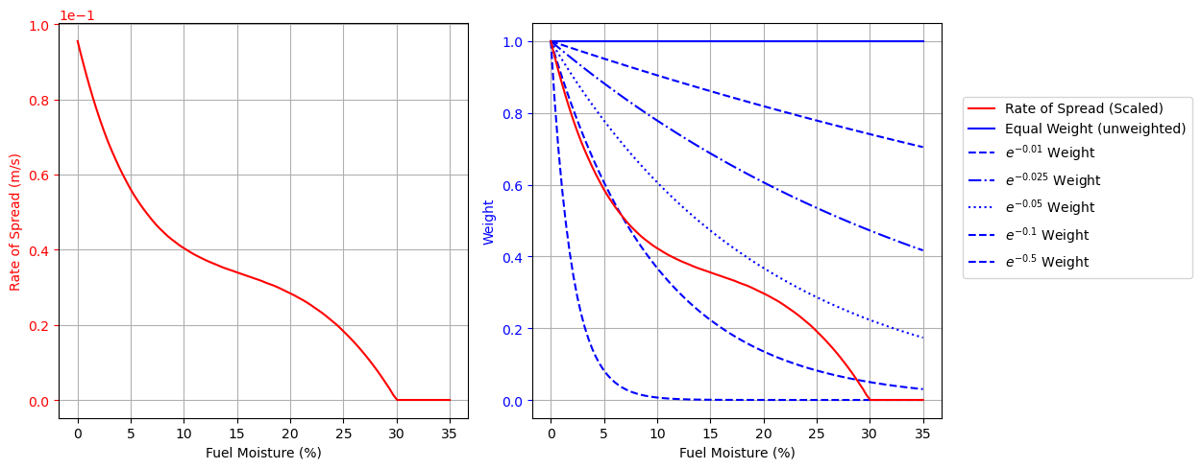
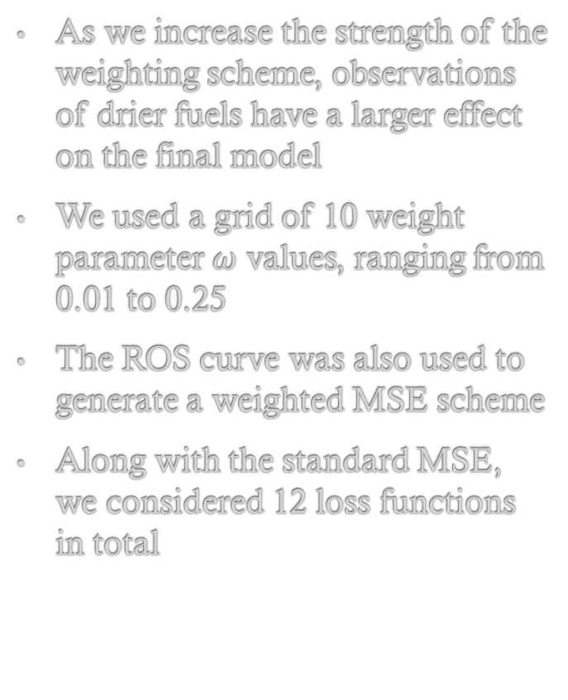
Proposed Loss Functions
As we increase the strength of the weighting scheme, observations of drier fuels have a larger effect on the final model
We used a grid of 10 weight parameter $ω$ values, ranging from 0.01 to 0.25
The ROS curve was also used to generate a weighted MSE scheme
Along with the standard MSE, we considered 12 loss functions in total
Weights Visualization

Slide 27
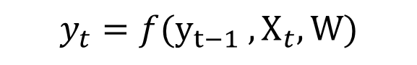
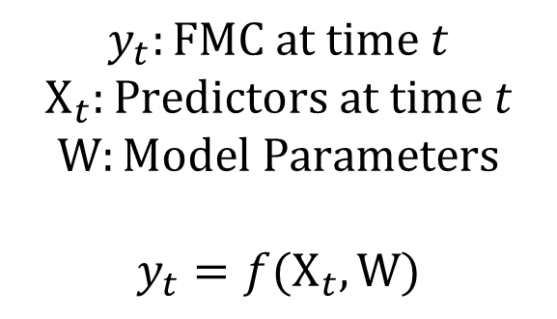
Machine Learning Models of FMC
“Static” models map the predictor data at a given time to the response variable at the same time
“Recursive” models relate the response variable at a given time to the response variable in the past
In this project, static models used for simplicity
Future research will use recursive models, such as Recurrent Neural Networks
Static Model
$$y_{t}:FMC at time t$$
$$X_{t}:Predictors at time t$$
$$W:Model Parameters$$
$$y_{t}=f(X_{t}, W)$$
Recursive Model
$$y_{t}=f({y_{t−1} ,X}_{t}, W)$$

Slide 28
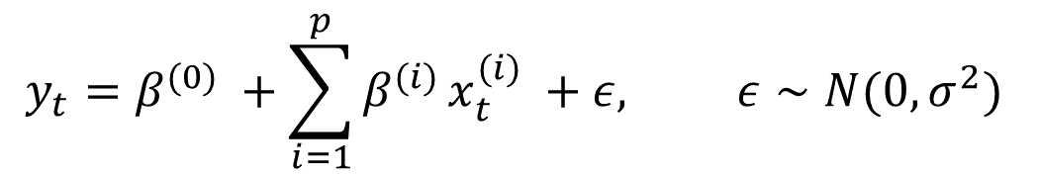
Machine Learning Models of FMC
Linear Regression
Linear relationship assumed between response and predictors
Random error assumed to be independent and identically distributed
$$y_{t}=β^{(0)} +\sum_{i=1}^{p}{β^{(i)}}x_{t}^{(i)} +ε, ε∼N(0, σ^{2})$$
Predictor Name | Units | Description
Equilibrium Moisture | % | Derived from RH and temperature
Precipitation | mm/h | Calculated from all rain accumulated over the hour
Wind Speed | m/s | Wind speed at 20ft above from
Solar Radiation | kWh/m² | Downward shortwave radiation
Elevation | feet | Height above sea level
Hour | hours | From 0 to 23, UTC time
Day of Year | days | From 0 to 365 or 366*
Latitude | degrees | North to South spatial coordinate
Longitude | degrees | East to West spatial coordinate
All Predictor Variables

Slide 29
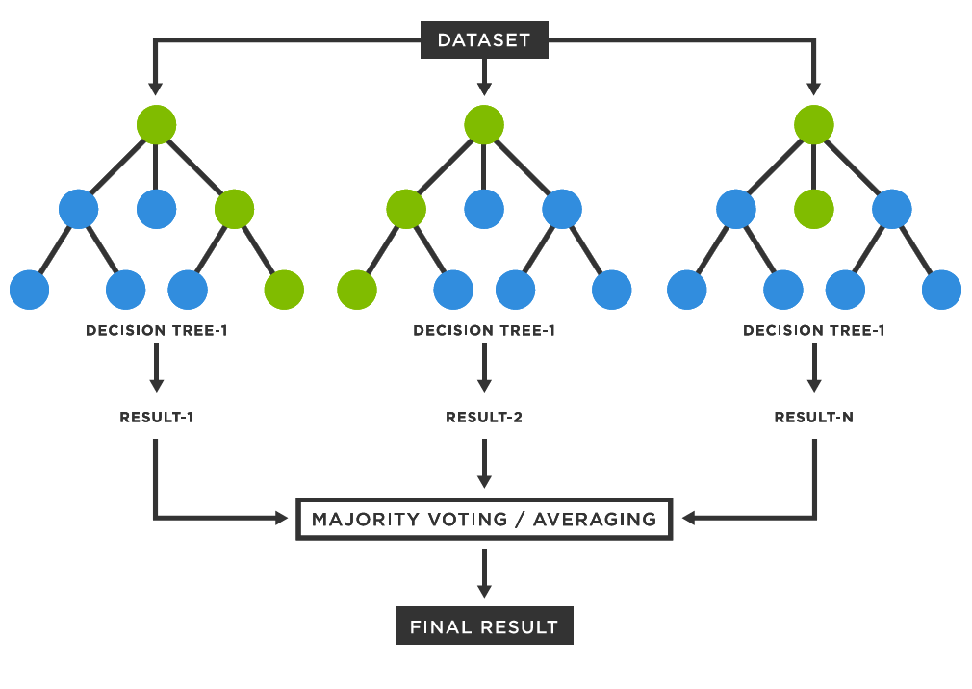
Machine Learning Models of FMC
Random Forest Visualization
Linear Regression
Random Forest
Ensemble Regression Tree-based method
For each regression tree, a random sample of predictors is chosen, and a bootstrap sample of the training data is taken
For each tree, the data is partitioned based on which partition leads to the greatest reduction in the loss function
The final model prediction averages over all trees
Gunay (2023)

Slide 30
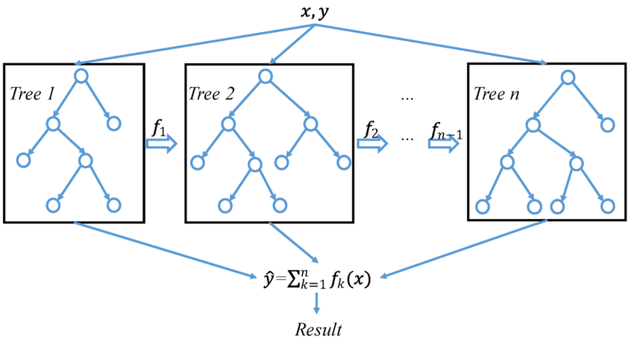
Machine Learning Models of FMC
Linear Regression
Random Forest
XGBoost
Modern implementation of gradient tree boosting
Ensemble Regression Tree-based method
Recursive method where simple trees are built and residuals are used to iteratively reweight the data
XGBoost Visualization
Wang (2019)

Slide 31
Cross-Validation & Prediction Error
Cross-validation (CV) is a set of methods used to estimate prediction error
The general idea is to…
Train models on a subset of the data on a Training Set
Predict the values of new data not used to train the model on a Test Set
When the data has spatial and temporal relationships, care must be taken when conducting cross-validation to avoid “data leakage”

Slide 32
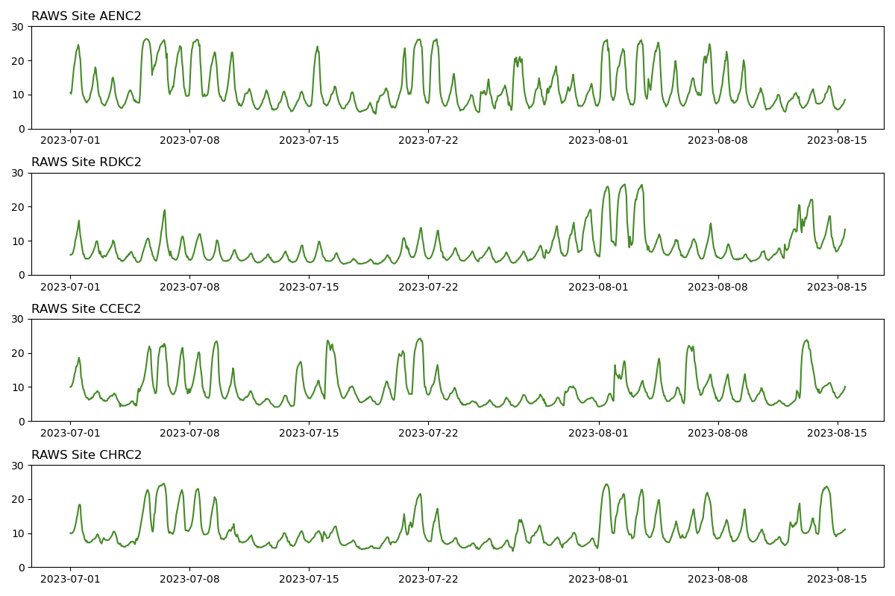
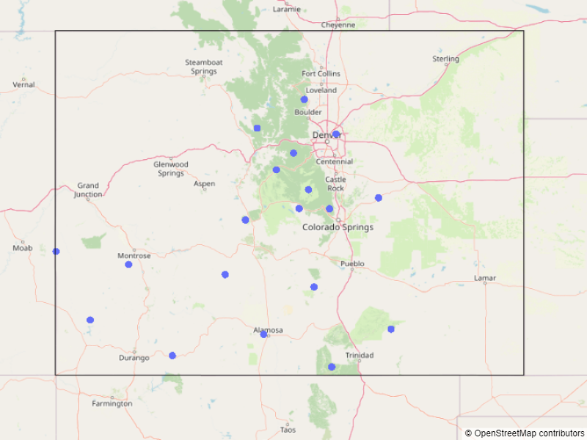
Cross-Validation & Prediction Error
How do we use this data to estimate error associated with predictions?

Slide 33
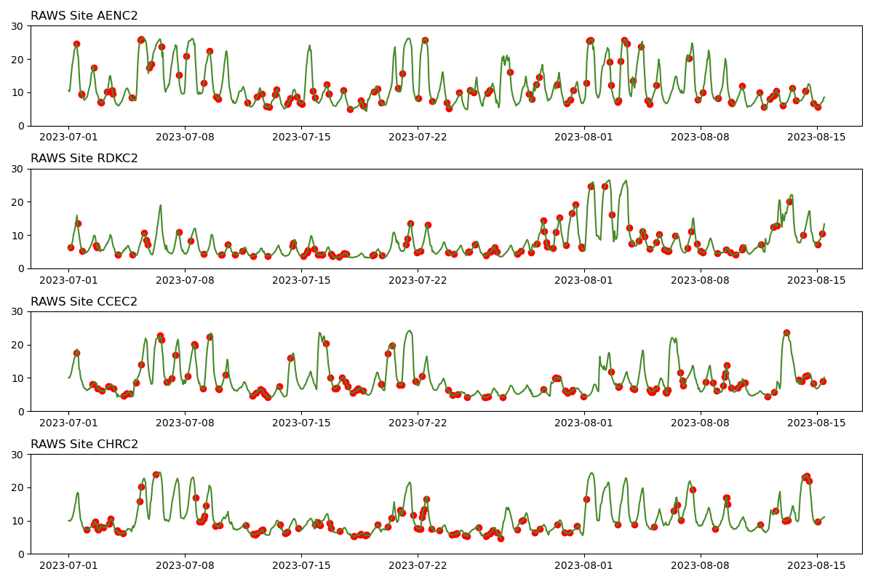
Cross-Validation Scheme – Random Split
The typical method in ML is to randomly select datapoints for inclusion in the test set
This leads to data leakage in both space and time
: Train
: Test

Slide 34
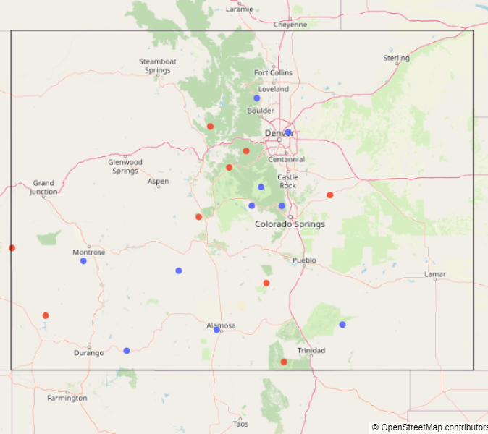
Cross-Validation Scheme – Spatial Holdout
An improvement is to randomly sample locations to holdout for test set
Solves data leakage in space
Still suffers from data leakage in time
: Train
: Test

Slide 35
Cross-Validation Scheme – Spatiotemporal Holdout
Build test set using locations not in training set and at times in the future of all observations in the training set
Solves data leakage in space & time
: Train
: Test

Slide 36
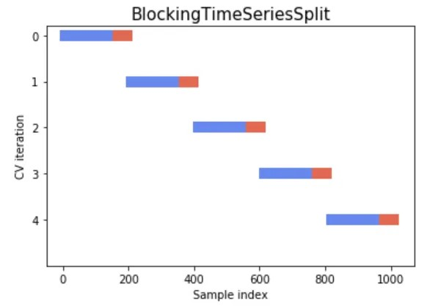
Experimental Design – Main Analysis
Cross-Validation Scheme: starting from earliest time…
Select 30 days of data
Randomly select 20% of RAWS sites for test set
Train on first 28 days of data (on remaining 80% of locations)
Predict final 2 days of data (on the test set of 20% of locations)
Move 30 window over by 2 days
Time Series Block Split
: Train
: Test
In each cross-validation iteration…
Train & Predict with all 3 models using all 12 loss functions
Calculate RMSE for FMC & ROS predictions
Move 30 window over by 2 days
167 total iterations, repeat 5 times
CV with Blocked Subsets
Source: Soumya Shrivastava 2020

Slide 37
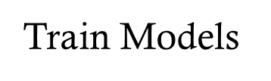
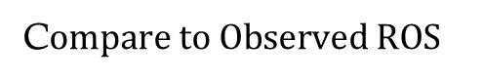
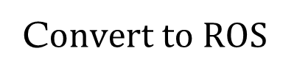

Experimental Design – Main Analysis
For each train period
Fit 3 models using 12 loss functions
For each testing time period
Predict test set
Convert FMC predictions to ROS
Compare ROS predictions to ROS values from observed FMC data
Combine results by loss function, so average RMSE for a given loss function is a combination of 3 models
Train Models
P$redict FMC$
C$onvert to ROS$
C$ompare to Observed ROS$

Slide 38
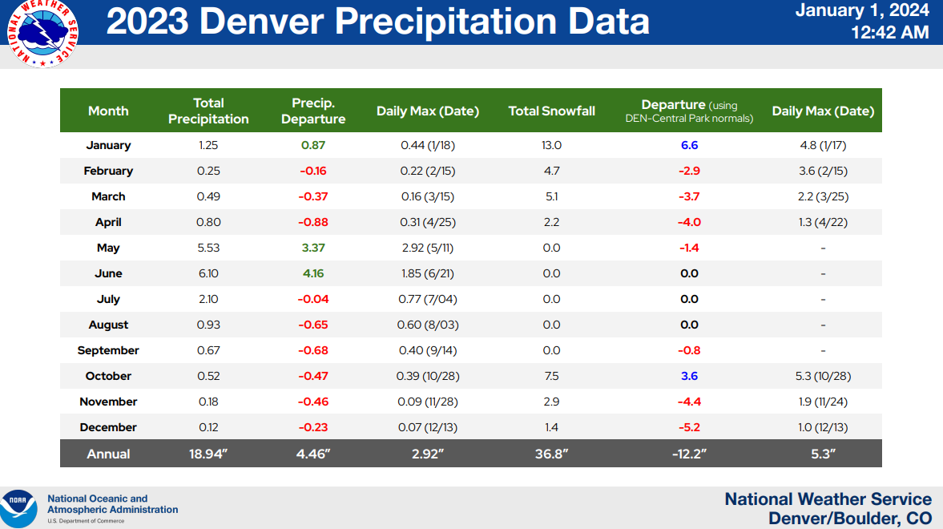
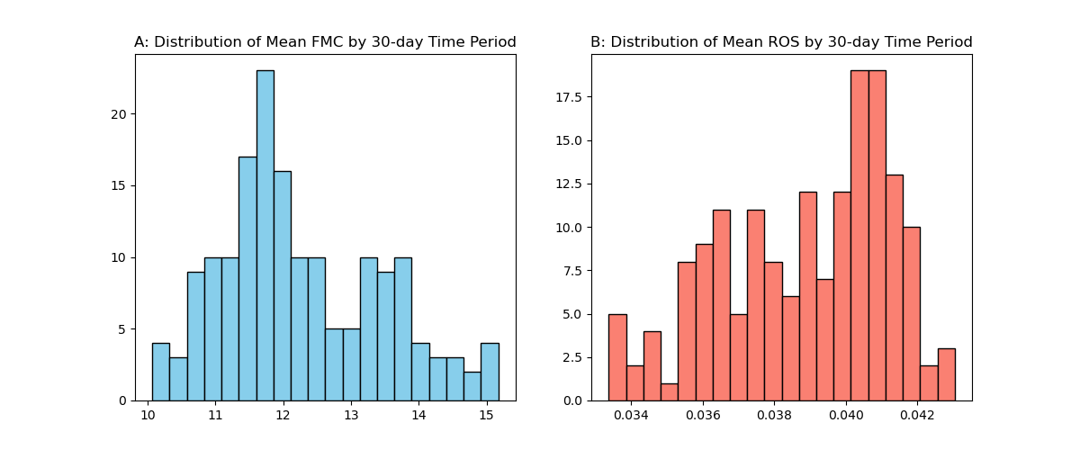

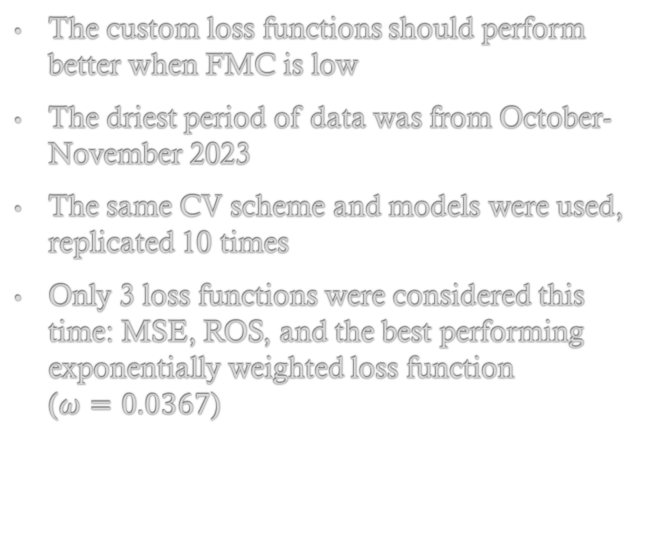

Experimental Design – Supplementary Analysis Driest Month
The custom loss functions should perform better when FMC is low
The driest period of data was from October-November 2023
The same CV scheme and models were used, replicated 10 times
Only 3 loss functions were considered this time: MSE, ROS, and the best performing exponentially weighted loss function ($ω=0.0367$)

Slide 39
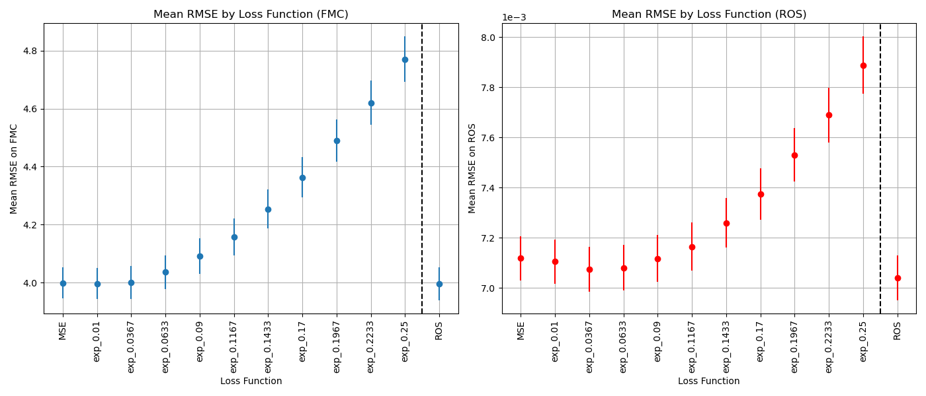
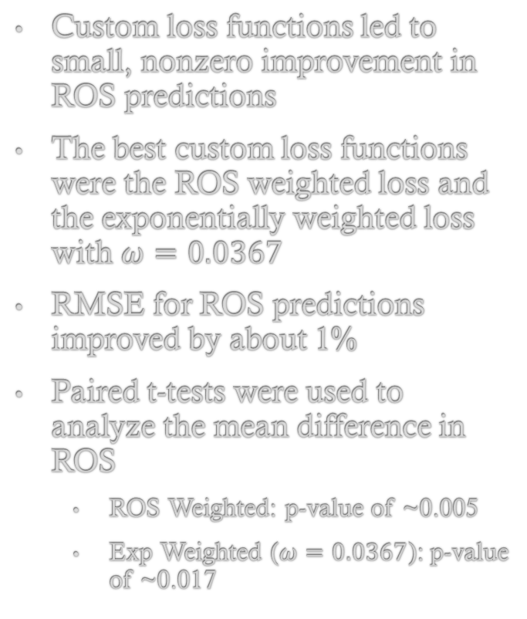
Results – Main Analysis
Custom loss functions led to small, nonzero improvement in ROS predictions
The best custom loss functions were the ROS weighted loss and the exponentially weighted loss with $ω=0.0367$
RMSE for ROS predictions improved by about 1%
Paired t-tests were used to analyze the mean difference in ROS
ROS Weighted: p-value of ~0.005
Exp Weighted ($ω=0.0367$): p-value of ~0.017

Slide 40

Results – Driest Month Analysis
The improvement in ROS predictions was much greater in the driest month
RMSE for ROS predictions improved by
4.7% for the ROS weighted loss
3.4% for Exp. weighted loss
Paired t-tests on mean difference in RMSE showed p-values of less than 0.01 for both
Loss Function | Mean RMSE | Min | Max
MSE | 5.862e-3 | 4.091e-3 | 8.082e-3
$$exp_0.0367$$ | 5.665e-3 | 3.913e-3 | 7.539e-3
ROS | 5.586e-3 | 3.886e-3 | 7.401e-3

Slide 41

Discussion & Conclusions
This analysis showed promising signs that custom loss functions can improve ROS predictions
Custom loss functions showed the biggest improvement for the driest times when ROS was the highest
It is relatively easy to apply the custom loss functions into ML models of FMC, so we plan on doing this in the future for recursive FMC models and real wildfire simulations
Loss Function | Mean RMSE | Min | Max
MSE | 5.862e-3 | 4.091e-3 | 8.082e-3
$$exp_0.0367$$ | 5.665e-3 | 3.913e-3 | 7.539e-3
ROS | 5.586e-3 | 3.886e-3 | 7.401e-3
1-year results
Driest month results

Slide 42


Limitations & Further Research
Optimal custom loss functions may be different for different fuels. Here we only considered a fuel type 8 (“closed timber litter”), which is closest to the 10-h FMC sensors
Look at longer time periods, larger spatial domains
Look at models trained on numerical weather model or satellite data
Apply Custom Loss Functions to more realistic physical models of FMC, such as autoregressive models or Recurrent Neural Networks
Use FMC models trained with Custom Loss on real wildfire simulations
RNN Diagram
VIIRS Satellite Data

Slide 43
Key References
SynopticPy Software Package: https://github.com/blaylockbk/SynopticPy/
NCAR XGBoost model of FMC (Schreck 2023): https://arxiv.org/abs/2305.11910
OpenWFM: https://wiki.openwfm.org/wiki/WRF-SFIRE_user_guide
WRF-SFIRE FMC Model (Mandel et al. 2014): http://www.nat-hazards-earth-syst-sci.net/14/2829/2014/
- Primary author MS Committee Chair Jan Mandel
CIRA Guide to Custom Loss Functions: https://arxiv.org/abs/2106.09757
- Authors include MS Committee Member Kyle Hilburn
Recurrent Neural Network for FMC developments: https://www.ugn.cas.cz/event/2023/sna
- Primary author Jan Mandel, second author Jonathon Hirschi

Slide 44

Thank You!
All data collection and analysis performed in Python
Data collection code: https://github.com/openwfm/wrfxpy/blob/develop-72-jh/
Analysis code: https://github.com/jh-206/Custom-Loss-FMDA/
Durango, CO – Uncover Colorado

